Slide 1
High-Frequency Trading Module 5 – genetic and self-learning algos
Slides to accompany High-Frequency Trading: A Practical Guide to Algorithmic Strategies and Trading Systems, 2nd edition, by Irene Aldridge

Slide 2
Outline
1. Genetic Algos
2. Self-Learning Algos
1.1 Definition
1.2 Principles
1.3 Examples
2.1 Datamining
2.2 Prediction
2.3 Examples

Slide 3
1.1 Genetic Algos
Definition
Applications
Algo that dynamically finds the best fit
for a given property of the distribution
for a given sample of the distribution (the full distribution is not observed)
Any data-intensive application
Use data sample to infer the entire distribution
Determine how the entire data stream evolves based on

Slide 4
1.1 Genetic Algos
History
Adoption in finance
First developed in genetics to track gene recombination and the resulting outcomes
Since then, used in pattern recognition:
Biometrics
Image recognition
Financial application development
Components used in econometric models
Particularly when the entire population is not known
Some financial applications

Slide 5
1.1 In HFT…
Genetic Algos = starting point
Genetic Algo Process
Work well with limited data
Resample existing data samples to generate “simulated” distribution
A genetic algo:
Selects dominant “features”
When you have no idea what you are looking for, the genetic algo data-mines common characteristics in the data
Build better “features” based on previously found ones
Look for tighter fit

Slide 6
1.2 Genetic Algos
Process
Start with data
Resample data and create distribution (bootrstrap data)
Parse for common features of data
Infer dominant features
Modify features for closer fit
Feature or factor
data

Slide 7
1.2 Data generation and bootstrap
Process
Sample data
limited samples are okay
Great for starter HFT with little collected data
Resample data
Various resampling methodologies can be used
Uniform resampling is common

Slide 8
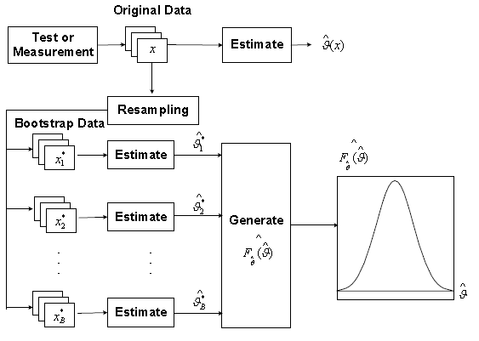
1.2 Data generation and bootstrap
Source: Sun, Tsung. Qu (2004)

Slide 9
1.2 Algorithm design
Feature discovery
Implementation: Five steps
Most commonly used Genetic Algos: Genetic Programming
Genetic programming develops linear feature connections
More general genetic algos may deploy more sophisticated econometrics
Design function sets and terminal sets
Generate an initial population randomly
Evaluate the individuals by the fitness criterion predetermined according to the given problem
Genetic operations with some possibilities, such as crossover and mutation
Termination condition

Slide 10
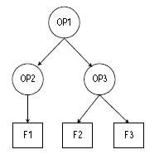
1.2 Feature discovery
How does data evolve?
Determine data operators OP
Determine initial features that result from operators, F

Slide 11
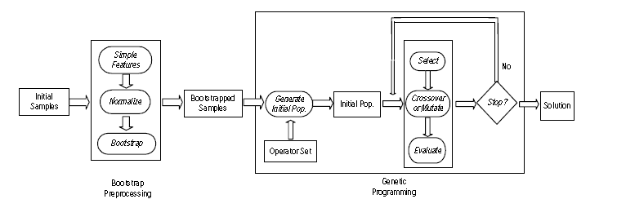
1.2 Feature discovery
Source: Sun, Tsung, Qu (2004)

Slide 12
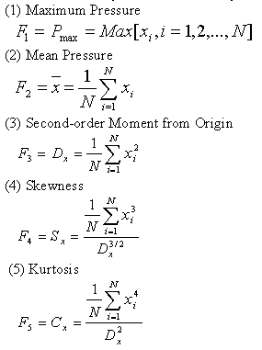

1.3 Genetic Programming Example
Determining Initial Features
Pick initial features
Time series (e.g., returns, volatility, etc.)
Candidate initial features can be sample statistics
Simple distributional properties:

Slide 13
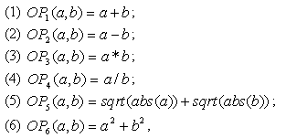
1.3 Example: Operator selection
Operands on the features
Simple functions can do
Start with the initial features
Basic stats
Implement the following operands on each two features

Slide 14

1.3 Example: Fitness Criterion
A fitness function
Design arbitrary “classes” for evaluating fitness
Basic example
For every two classes i and j,
D_{ij}^{b} = distance between two classes
D_{i}^{w} = distance within each class
α = inter-class exponent
β = intra-class exponent

Slide 15
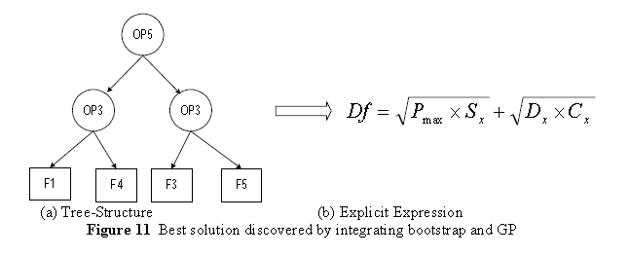
1.3 Example
Source: Sun, Tsung, Qu (2004)

Slide 16
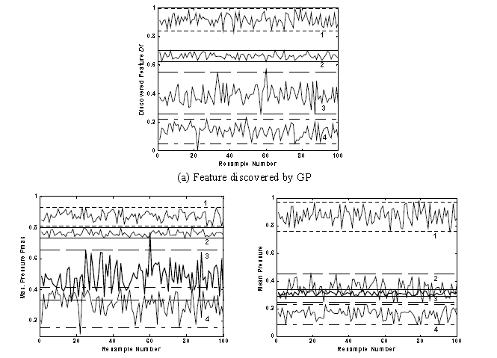
1.3 Example: feature discovery

Slide 17
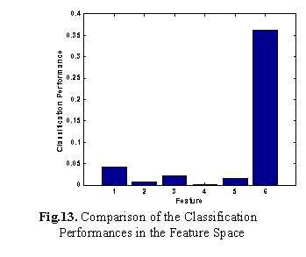
1.3 Example: feature discovery
Discovered
feature

Slide 18
1. Genetic Algorithms: summary
Features
Issues
Deploys optimization to find the best –fitting function among several alternatives
Can run on relatively small data sizes
Fairly straightforward
Initial set of functions needs to be specified
Functions may have no relation to real-life processing, generate spurious predictions
Over-reliance may result in in-sample bias

Slide 19
Outline
1. Genetic Algos
2. Self-Learning Algos
1.1 Definition
1.2 Principles
1.3 Examples
2.1 Datamining
2.2 Prediction
2.3 Examples

Slide 20
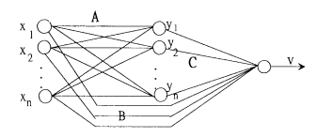
2.1 Self-learning algos
History
Adaptive critic element
Originated in control theory
Key principles:
Algo observes the process environment, and makes the appropriate decision
The algo further observes the results of its decision and further improves on the algo
The algo is “tuned” by training
The action-evaluation network

Slide 21
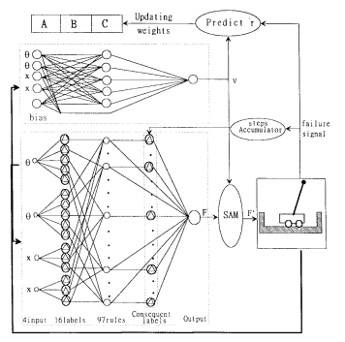
2.1 Design

Slide 22
2.1 Self-learning algorithms
Essence
Data
010111010101110101010101010101001010010101010111010
Self-learning comprises of the following steps:
Data-mining (in-sample prediction)
Out-of-sample testing
Fine-tuning based on outcome
Spaghetti principle
= see what sticks
Apply out-of-sample, see if still works

Slide 23
2.1 Classification
Supervised learning
Unsupervised learning
Regression
Neural network
Boosting
SVM
…
Clustering
Reinforcement learning
…

Slide 24
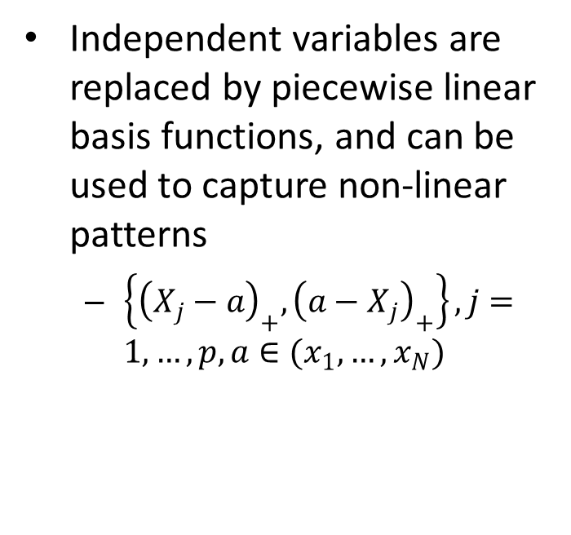
2.2 Classification examples
Linear regression
Multivariate Adaptive Regression Systems (MARS)
Decide on dependent and independent variables
LASSO
Independent variables are replaced by piecewise linear basis functions, and can be used to capture non-linear patterns
$\left\{{\left(X_{j}−a\right)}_{+}, {\left(a−X_{j}\right)}_{+}\right\}, j=1, …, p, a∈(x_{1}, …,x_{N})$
Additional design specifications:
Window sizes for training and testing
Choice of holding period
Additional predictors

Slide 25
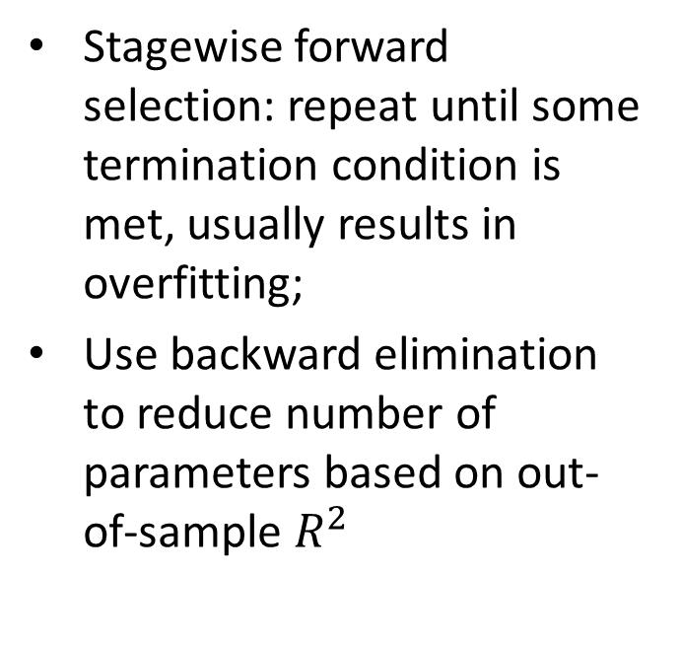
2.2 MARS
Process
Boosting
Stagewise forward selection: repeat until some termination condition is met, usually results in overfitting;
Use backward elimination to reduce number of parameters based on out-of-sample $R^{2}$
Robust to overfitting
Compute mis-prediction error, with weights for data
Err = sum*w*I(y <> G(x), theta)
Compute alpha = log ((1-err)/err)
Update weights w <- w*exp(alpha*I(y <> G(x, theta)))
Repeat
Final output: G(x, theta)

Slide 26
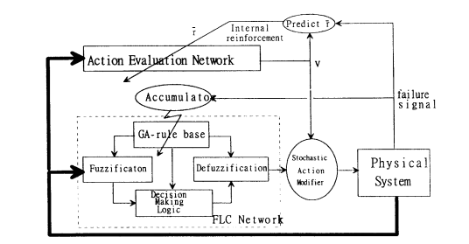
2.3 Example

Slide 27


2.3 Example
Characteristics
Process
Random data with fixed but unknown distribution D
Goal: to find a function which minimizes the generalization error:
Expected value:
Define accuracy as follows:
Natural error estimator:

Slide 28
2.3 Summary
Features
Drawbacks
Adaptive
Can work with any data
Prone to over-fitting
May generate spurious results

Slide 29
Outline
1. Genetic Algos
2. Self-Learning Algos
1.1 Definition
1.2 Principles
1.3 Examples
2.1 Datamining
2.2 Prediction
2.3 Examples

